Slide 1
MySQL Assignment

Slide 2
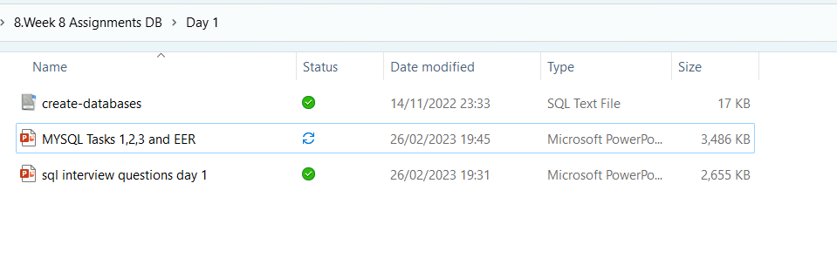
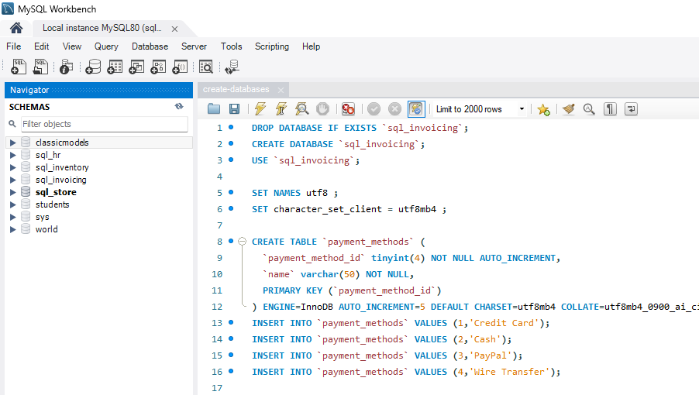
Import and execute SQL Script from files
Download and import create-databases SQL script into MySQL Workbench.
Run the script and create databases.

Slide 3
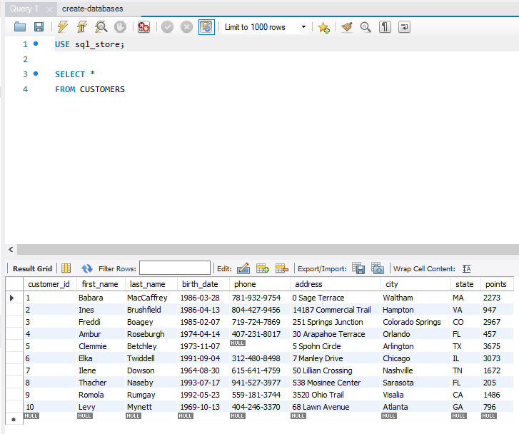
Query 1
Input the following into the file Query 1
USE sql_store;
SELECT *
FROM customers;

Slide 4
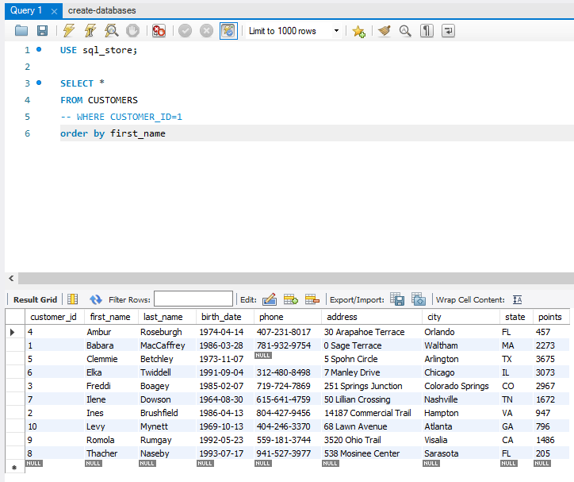
Query 1 Continued…
Add the following into the file Query 1
-- WHERE CUSTOMER_ID=1
order by first_name
Notes:
Run the query

Slide 5
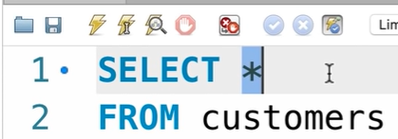
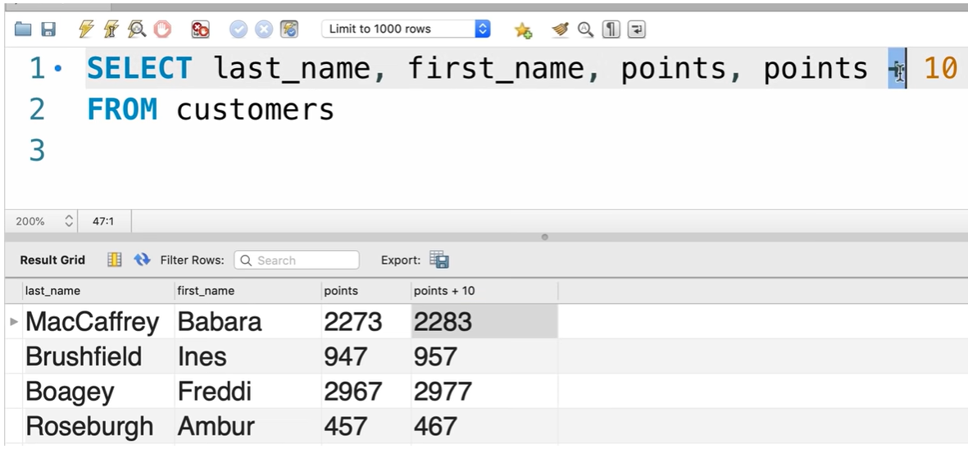
Query 2 SELECT
SELECT last_name, first_name, points, points + 10
FROM CUSTOMERS
Notes:
Here we have added the last name first and then the first name. The next task is to add the original point and the points pulse 10 .

Slide 6
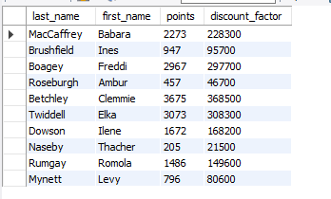
Task 1
Using the Query 2 you created change the points to reads times by 10 and plus 100. Record your results in your word document
Change the Query 2 code to create a discount factor so the table now shows a discount header and changing the (point + 10) *100
Record your results in your word document

Slide 7

Task 2
Write a SQL query to return all the products in our database in the result set. I want you to show columns; name, unit price, and new column called new price which is based on this expression, (unit price * 1.1 ).
So what you are doing is increasing the product price of each by 10%.
So with the query we want all the products the original price and the new price.

Slide 8
Task 3
In this task create a new query to find all the customers with a birth date of > '1990-01-01'

Slide 9
Task 4
Select sql_inventory.
Write a query to find out the name of the product with most amount in stock.

Slide 10
Task 5
Select sql_inventory.
Write a query to find out the name of the most expensive product.

Slide 11
Task 6
Select sql_store.
Write a query to find out the first name, last name, address and the birthdate of the oldest customer.

Slide 12
Creating an EER Diagram

Slide 13
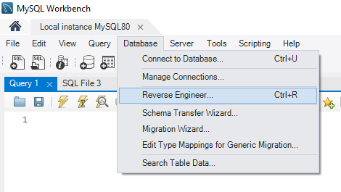

Slide 14
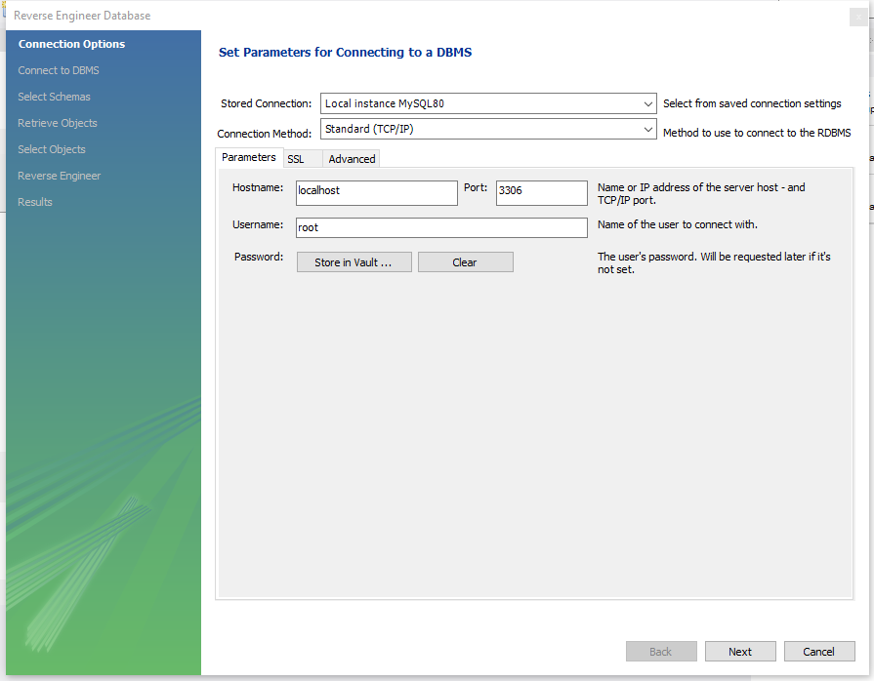

Slide 15
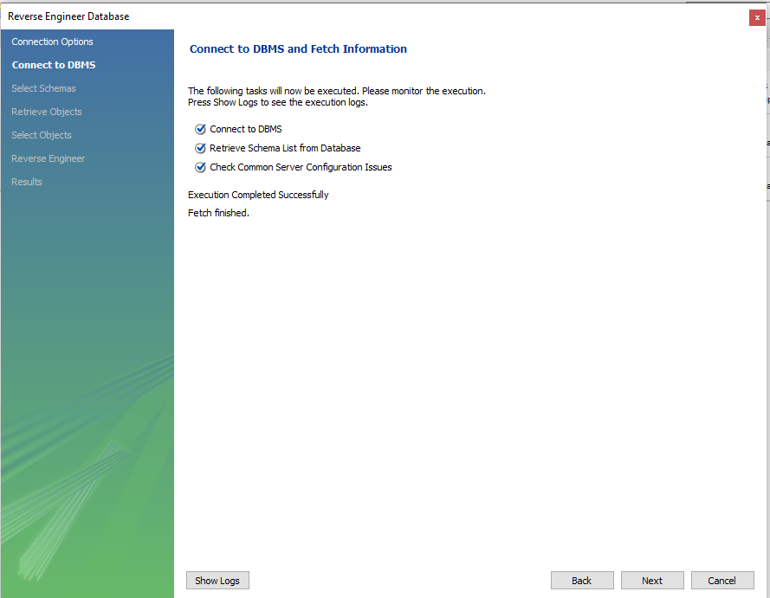

Slide 16
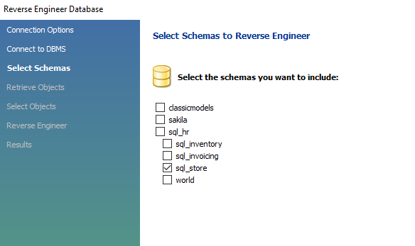
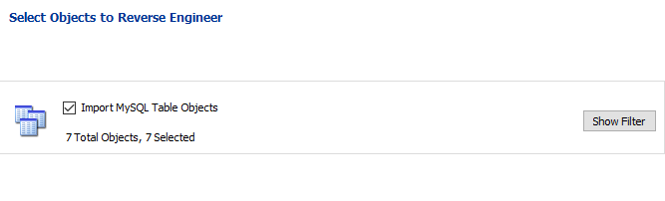

Slide 17
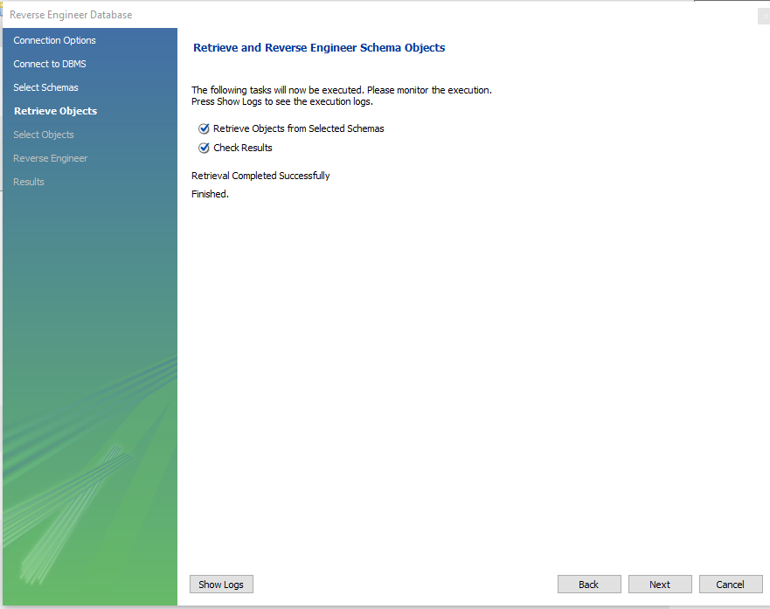

Slide 18
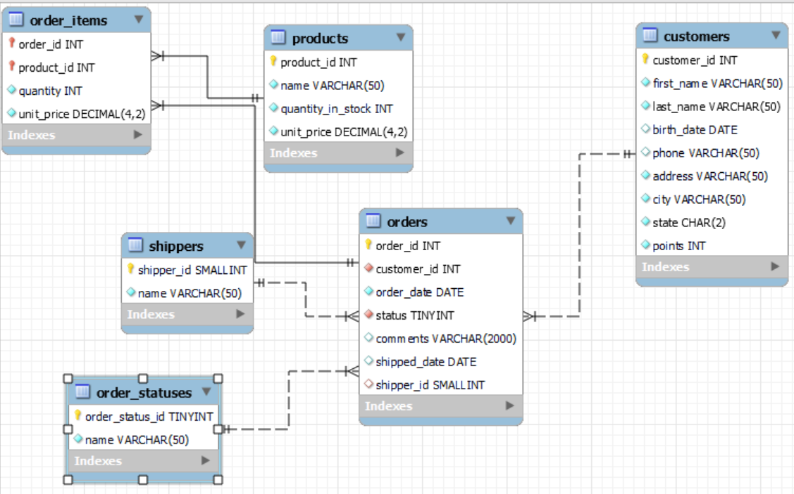
Your EER Diagram should look like this.
Rearrange you EER data to fit on one page
Save the screenshot of EER diagram in your word document
Write about the relationship between tables. Primary and Foreign keys. (Few words about tables)

Slide 19
Submit your assignment
Please submit the files and assignments on Teams Assignment page – Click on Hand IN when you are happy to submit.

